Slide 1
„Java – overview and basics”

Slide 2
Literature
English-language sites:
http://java.sun.com //still works
http://www.javaworld.com
http://www.javalobby.com
… Thousands of others
Polish-language sites:
http://www.java.pl
http://www.jdn.pl
Books:
„Thinking in Java” Bruce Eckel
English edition:
http://www.bruceeckel.com
(older free, newest payable)
Polish Edition:
http://www.helion.pl
Core Java, Volume I - Fundamentals (9th edition) by Cay Horstmann and Gary Cornell
"Head first Java" by Kathy Sierra and Bert Bates
"Core Java, Volume II " Advanced Features (9th edition) by Cay Horstmann and Gary Cornell

Slide 3
What is Java?
Programming language
Platform
Java language:
Simple
Architecture neutral
Object oriented
Portable
Secure
Distributed
High performance
Interpreted
Multithreaded

Slide 4
Brief history
1990 – suggestion in report „Further” concerning creation of new object oriented environment
1991 – OAK („Object Application Kernel”) language (James Gosling)
1995 – new language name: „Java”
1996 - Netscape compatible with Java 1.0. Sun propagates Java 1.0 environment
2001 – Java 1.4.0 – over 2100 classes library
2004 – Java 1.5.0
2007 – Java 1.6.0
2019 – Java 1.11.0

Slide 5
Java – compiled and interpreted
One compilation
Many interpretations

Slide 6
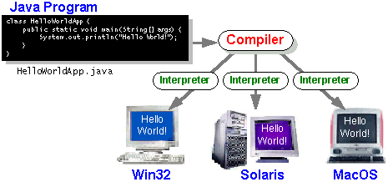
Java – compiled and interpreted

Slide 7
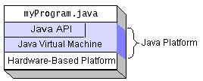
Java platform
The Java platform has two components:
The Java Virtual Machine (Java VM)
The Java Application Programming Interface (Java API)

Slide 8
Java features
The essentials: Objects, strings, threads, numbers, input and output, data structures, system properties, date and time, and so on.
Applets: The set of conventions used by applets.
Networking: URLs, TCP (Transmission Control Protocol), UDP (User Datagram Protocol) sockets, and IP (Internet Protocol) addresses.
Internationalization: Help for writing programs that can be localized for users worldwide. Programs can automatically adapt to specific locales and be displayed in the appropriate language.

Slide 9
Java features (2)
Security: Both low level and high level, including electronic signatures, public and private key management, access control, and certificates.
Software components: Known as JavaBeansTM, can plug into existing component architectures.
Object serialization: Allows lightweight persistence and communication via Remote Method Invocation (RMI).
Java Database Connectivity (JDBCTM): Provides uniform access to a wide range of relational databases.

Slide 10
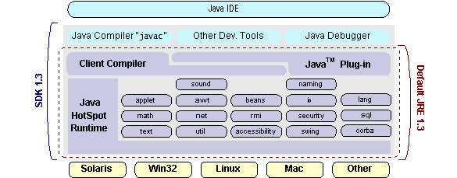
SDK & JRE
Standard Development Kit
Java Runtime Enviroment

Slide 11
Linux installation instructions
1) Copy j2sdk-1_6_0_<version number>-linux-i586.bin to the directory into which you want to install the Java 2 SDK.
(example:) /usr/local/
2) Run j2sdk-1_6_0_<version number>-linux-i586.bin
chmod a+x j2sdk-1_6_0_<version number>-linux-i586.bin
./j2sdk-1_6_0_<version number>-linux-i586.bin
3) Set enviromental variables to point jdk installation:
export PATH=$PATH:/pathtojdk/bin
export CLASSPATH=$CLASSPATH:/pathtojdk/lib:.
(example:)
export PATH=$PATH:/usr/local/j2sdk-1_4_0_01/bin

Slide 12
Linux installation instructions(2)
Question:
What is the first thing you should check if the interpreter returns the error:
Exception in thread "main"
java.lang.NoClassDefFoundError: HelloWorldApp.java.
Answer: Check your CLASSPATH. Probably current working directory is not included.

Slide 13
Important tools
All tools are in pathtojdk/bin/ directory:
javac - compiler,
java - interpreter,
javadoc – generator of API documentation,
appletviewer – applet browser,
jar – tool for jar files
jdb - debuggger,

Slide 14
Creating first application
Create a Java source file. A source file contains text, written in the Java programming language, that you and other programmers can understand.
Compile the source file into a bytecode file. The Java compiler, javac, takes your source file and translates its text into instructions that the Java Virtual Machine (Java VM) can understand. The compiler puts these instructions into a bytecode file. Run the program contained in the bytecode file. The Java VM is implemented by a Java interpreter, java. This interpreter takes your bytecode file and carries out the instructions by translating them into instructions that your computer can understand.

Slide 15
Creating first application
1. Write following code:
class HelloWorldApp {
public static void main(String[] args) {
System.out.println("Hello World!"); // Display "Hello World!"
} }
2. Compile it:
javac HelloWorldApp.java
3. Run the program:
java HelloWorldApp

Slide 16
Creating first applet
Write following code:
import java.applet.*;
import java.awt.*;
public class HelloWorld extends Applet {
public void paint(Graphics g) {
g.drawString("Hello world!", 50, 25); // Display "Hello world!"
} }

Slide 17
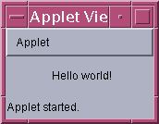
Creating first applet (2)
2. Write HTML file (HelloWorld.html):
<HTML>
<HEAD> <TITLE>The Hello World Applet</TITLE> </HEAD> <BODY>
<APPLET CODE="HelloWorld.class" WIDTH=150 HEIGHT=25> </APPLET> </BODY> </HTML>
3. Compile the source file:
javac HelloWorld.java
4. Run the program:
appletviewer HelloWorld.html

Slide 18
Comments in Java Code
The Java language supports three kinds of comments:
/* text */
The compiler ignores everything from /* to */.
/** documentation */
This indicates a documentation comment The compiler ignores this kind of comment, just like it ignores comments that use /* and */. The JDK javadoc tool uses doc comments when preparing automatically generated documentation.
// text
The compiler ignores everything from // to the end of the line.

Slide 19
Defining a class
Class (template)
Instanciation – creation of an Object
Variables
Methods

Slide 20
The main method
public static void main(String[] args)
To launch an application is necessary to implement this method.
If no, the similar error message is displayed by compiler:
In class NoMain: void main(String argv[]) is not defined
2. The main method accepts a single argument: an array of elements of type String.

Slide 21
Using an instance method or variable
System.out.println(„HelloWorld”);
System – class
System.out – full name of variable out. When the System class is loaded into the application, it instantiates PrintStream and assigns the new PrintStream object to the out class variable
PrintStream – type of object out. It has method: println(String);

Slide 22
Importing classes and packages
1) import java.applet.Applet;
import java.awt.Graphics;
public class HelloWorld extends Applet {
public void paint(Graphics g) { g.drawString("Hello world!", 50, 25); } }
public class HelloWorld extends java.applet.Applet {
public void paint(java.awt.Graphics g) { g.drawString("Hello world!", 50, 25); } }

Slide 23
Importing classes and packages (2)
Packages are used to group classes, similar to the way libraries are used to group C functions.
Every class is in package
If the source code for a class doesn't have a package statement at the top, declaring the package the class is in, then the class is in the default package.
Within a package, all classes can refer to each other without prefixes. For example, the java.awt Component class refers to the java.awt Graphics class without any prefixes, without importing the Graphics class.

Slide 24
Common Compiler problem
Can't Locate the Compiler
javac: Command not found
Solution:
Modify your PATH environment variable so that it includes the directory where the Java compiler lives.

Slide 25
Common Interpreter problem
Can't Find Class
Can't find class HelloWorldApp.class
Solution:
The argument to the Java interpreter is the name of the class that you want to use, not the filename (HelloWorldApp instead of HelloWorldApp.class)

Slide 26
Java language

Slide 27
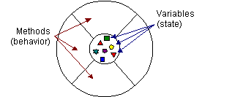
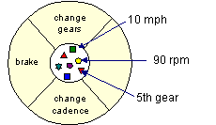
Object Oriented Programming (OOP) concepts
An object is a software bundle of variables and related methods.
Visual representation of a software object:
Bicycle modeled as a software object:

Slide 28
OOP concepts (2)
Encapsulation benefits:
Modularity: The source code for an object can be written and maintained independently of the source code for other objects. Also, an object can be easily passed around in the system.
Information hiding: An object has a public interface that other objects can use to communicate with it. The object can maintain private information and methods that can be changed at any time without affecting the other objects that depend on it.

Slide 29
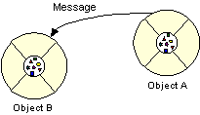
OOP concepts (3)
Message
Software objects interact and communicate with each other by sending messages to each other. When object A wants object B to perform one of B's methods, object A sends a message to object B

Slide 30
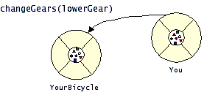
OOP concepts (4)
The three components of a message:
1) The object to which the message is addressed (YourBicycle)
2) The name of the method to perform (changeGears)
3) Any parameters needed by the method (lowerGear)

Slide 31
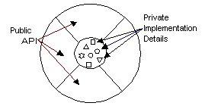
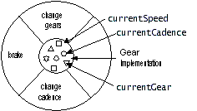
OOP concepts (5)
A class is a prototype that defines the variables and the methods common to all objects of a certain kind.
Visual representation of class:
Visual representation of bike class:

Slide 32
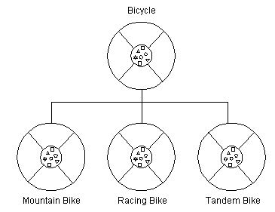
OOP concepts (6)
Inheritance
Superclass
Subclass

Slide 33
OOP concepts (7)
Inheritance benefits:
Subclasses provide specialized behaviors from the basis of common elements provided by the superclass. Through the use of inheritance, programmers can reuse the code in the superclass many times.
Programmers can implement superclasses called abstract classes that define "generic" behaviors. The abstract superclass defines and may partially implement the behavior, but much of the class is undefined and unimplemented. Other programmers fill in the details with specialized subclasses.

Slide 34
OOP concepts (8)
An interface is a device that unrelated objects use to interact with each other. It is most analogous to a protocol (an agreed on behavior).
Example: Inventory Interface
To work in the inventory program, the bicycle class must agree to this protocol by implementing the interface.
When a class implements an interface, the class agrees to implement all the methods defined in the interface.

Slide 35
OOP concepts (9)
Interfaces benefits:
Capturing similarities among unrelated classes without forcing a class relationship.
Declaring methods that one or more classes are expected to implement.
Revealing an object's programming interface without revealing its class.

Slide 36
Variables
An object stores its state in variables.
A variable is an item of data named by an identifier.
The variable's type determines what values it can hold and what operations can be performed on it.
To give a variable a type and a name, you write a variable declaration, which generally looks like this:
type name
A variable has scope.

Slide 37
Variables (2)
Every variable must have a data type
Java has two categories of data types: primitive and reference
A variable of primitive type contains a single value of the appropriate size and format for its type: a number, a character, or a boolean value
Arrays, classes, and interfaces are reference types. The value of a reference type variable, in contrast to that of a primitive type, is a reference to (an address of) the value or set of values represented by the variable.
A reference is called a pointer, or a memory address. The Java does not support the explicit use of addresses like other languages do. You use the variable's name instead.

Slide 38
Variables (3)
Primitive data types:
Keyword Size/Format
byte 8-bit
short 16-bit
int 32-bit
long 64-bit
float 32-bit
double 64-bit
char 16-bit
boolean true or false
The format and size of primitive data types is independent from the platform on which a program is running !

Slide 39
Variables (4)
Variable name:
1) It must be a legal identifier. An identifier is an unlimited series of Unicode characters that begins with a letter.
2 ) It must not be a keyword, a boolean literal (true or false), or the reserved word null.
3) It must be unique within its scope.

Slide 40
Variables (5)
By Convention :
Variable names begin with a lowercase letter.
Class names begin with an uppercase letter.
If a variable name consists of more than one word, the words are joined together, and each word after the first begins with an uppercase letter, like this: isVisible.
The underscore character (_) is acceptable anywhere in a name, but by convention is used only to separate words in constants (because constants are all caps by convention and thus cannot be case-delimited).

Slide 41
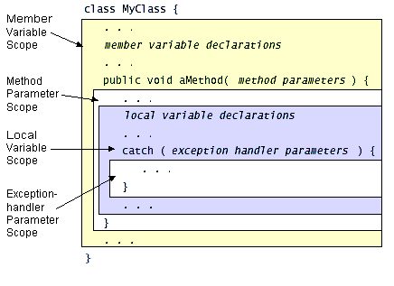
Variables (6)
A variable's scope is the region of a program within which the variable can be referred to by its simple name.
The location of the variable declaration within your program establishes its scope and places it into one of these four categories:

Slide 42
Variables (7)
The value of a final variable cannot change after it has been initialized. Such variables are similar to constants in other programming languages.
To declare a final variable, use the final keyword in the variable declaration before the type:
final int aFinalVar = 0;
It is possible declare the local variable and initialize it later (but only once):
final int blankfinal;
. . .
blankfinal = 0;

Slide 43
Variables (8)
Question:
Which of the following are valid variable names?
int
anInt
i
i1
1
thing1
1thing
ONE-HUNDRED
ONE_HUNDRED
Question:
Which of the following are valid variable names? Answer:
int
anInt
i
i1
1
thing1
1thing
ONE-HUNDRED
ONE_HUNDRED

Slide 44
Operators
An operator performs a function on one, two, or three operands.
Unary operators (example: ++) (postfix and prefix)
Binary operators (example: +) (infix)
Ternary operators ( example: ?:) (infix)

Slide 45
Operators (2)
Arithmetic operators:
Operator | Use | Description
+ | op1 + op2 | Adds op1 and op2
- | op1 – op2 | Subtracts op2 from op1
* | op1 * op2 | Multiplies op1 by op2
/ | op1 / op2 | Divides op1 by op2
% | op1 % op2 | Computes the remainder of dividing op1 by op2

Slide 46
Operators (3)
Arithmetic operators - conversions:
Data Type of Result | Data Type of Operands
long | Neither operand is a float or a double (integer arithmetic); at least one operand is a long.
int | Neither operand is a float or a double (integer arithmetic); neither operand is a long.
double | At least one operand is a double.
float | At least one operand is a float; neither operand is a double.

Slide 47
Operators (4)
Unary operators :
Operator | Use | Description
+ | + op | Promotes op to int if it's a byte, short, or char
- | – op | Arithmetically negates op
++ | op ++ | Increments op by 1; evaluates to the value of op before it was incremented
++ | ++ op | Increments ... (after)
-- | op -- | Decrements ... (before)
-- | -- op | Decrements ... (after)
! | ! op | Inverts the value of the boolean

Slide 48
Operators (5)
public class SortDemo {
public static void main(String[] args) {
int[] arrayOfInts = { 32, 87, 3, 589, 12, 8, 622, 127 };
for (int i = arrayOfInts.length; --i >= 0; ) {
for (int j = 0; j < i; j++) {
if (arrayOfInts[j] > arrayOfInts[j+1]) {
int temp = arrayOfInts[j];
arrayOfInts[j] = arrayOfInts[j+1];
arrayOfInts[j+1] = temp;
}
}
}
}
}

Slide 49
Operators (6)
Equality and Relational operators :
Operator | Use | Returns true if
> | op1 > op2 | op1 is greater than op2
>= | op1 >= op2 | op1 is greater than or equal to op2
< | op1 < op2 | op1 is less than op2
<= | op1 <= op2 | op1 is less than or equal to op2
== | op1 == op2 | op1 and op2 are equal
!= | op1 != op2 | op1 and op2 are not equal

Slide 50
Operators (7)
Conditional operators :
Operator | Use | Explanation
&& | op1 && op2 | Conditional AND
|| | op1 || op2 | Conditional OR
Operator ?: (if-then-else): int value1 = 1; int value2 = 2; int result; boolean someCondition = true; result = someCondition ? value1 : value2; System.out.println(result);

Slide 51
Operators (8)
Bit Shift operators :
Operator | Use | Description
>> | op1 >> op2 | shift bits of op1 right by distance op2
<< | op1 << op2 | shift bits of op1 left by distance op2
>>> | op1 >>> op2 | shift bits of op1 right by distance op2 (unsigned)
Question:
13 >> 1 = ?
Answer:
6
13(1101) >> 1 = 6 (0110)

Slide 52
Operators (9)
Bitwise operators :
Operator | Use | Operation
& | op1 & op2 | bitwise AND
| | op1 | op2 | bitwise inclusive OR
^ | op1 ^ op2 | bitwise exclusive OR (XOR)
~ | ~ op | Unary bitwise complement

Slide 53
Operators (10)
Assignments operators (examples):
Operator | Use | Equivalent to
+= (arithmetic) | op1 += op2 | op1 = op1 + op2
&= (logical) | op1 &= op2 | op1 = op1 & op2
>>= (shift) | op1 >>= op2 | op1 = op1 >> op2

Slide 54
Operators (11)
Other operators:
Operator | Description
[] | Used to declare arrays, create arrays, and access array elements
. | Used to form qualified names
{ params } | Delimits a comma-separated list of parameters
( type ) | Casts (converts) a value to the specified type

Slide 55
Operators (12)
Other operators:
The new operator creates a new object or a new array.
Example: creating a new Integer object from the Integer class in the java.lang package:
Integer anInteger = new Integer(10);
The instanceof operator tests whether its first operand is an
instance of its second.
op1 instanceof op2
op1 must be the name of an object and op2 must be the
name of a class. An object is considered to be an instance of a
class if that object directly or indirectly descends from that
class.

Slide 56
Operators (13) – instanceOf
class Parent {}
class Child extends Parent implements MyInterface {}
interface MyInterface {}
…
Parent obj1 = new Parent();
Parent obj2 = new Child();
System.out.println("obj1 instanceof Parent:” + (obj1 instanceof Parent));
…
Output ???
obj1 instanceof Parent: true or false ???
obj1 instanceof Child: true or false ???
obj1 instanceof MyInterface: true or false ???
obj2 instanceof Parent: true or false ???
obj2 instanceof Child: true or false ???
obj2 instanceof MyInterface: true or false ???
true
false
false
true
true
true
Notes:
obj1 instanceof Parent: true
obj1 instanceof Child: false
obj1 instanceof MyInterface: false
obj2 instanceof Parent: true
obj2 instanceof Child: true
obj2 instanceof MyInterface: true

Slide 57
Operators (14) – questions
1)
int i = 20;
int n = i++%4;
What are the values of i and n after the code is executed?
2)
int i = 20;
int n = ++i%5;
What are the values of i and n after the code is executed?
Notes:
1)
N=0
I=21
2)
N=1
I=21

Slide 58
Operators (15)
Operators precedence:
[] . (params) expr++ expr--
++expr --expr +expr -expr ~ !
new (type)expr
* / %
+ -
<< >> >>>
< > <= >=
== !=
&
^
|
&&
||
? :
= += -= *= /= %= &= ^= |= <<= >>= >>>=

Slide 59
Control Flow Statements
Statement type | Keyword
looping | while, do-while , for
decision making | if-else, switch-case
exception handling | try-catch-finally, throw
branching | break, continue, label:, return

Slide 60
While, do-while and for
while (expression) {
statement(s)
}
do {
statement(s)
} while (expression);
for (initialization; termination; increment) {
statement
}
for ( ; ; ) {
// infinite loop
... }

Slide 61
If, if-else and switch
if (expression) {
statement(s)
}
if (expression) {
// code to perform true
} else {
// code to perform false
}
switch (Variable) {
case 1: System.out.println(„1"); break;
default: System.out.println(„The number is wrong !");
break;
}
A switch works with:
byte, short, char, int
enumerated types (Enum),
String Character, Byte, Short, Integer classes

Slide 62
Try, catch and finally
try { // or try (…) called try-with-resources
statement(s)
}
catch (exceptiontype name) {
statement(s)
}
finally {
statement(s)
}

Slide 63
Break, continue and return
Break and continue:
1) break; || continue;
2) break label; || continue label;
Example (by analogy is continue):
...
search:
for ( ; i < arrayOfInts.length; i++) {
for (j = 0; j < arrayOfInts[i].length; j++) {
if (arrayOfInts[i][j] == searchfor) {
foundIt = true;
break search;
} } }
Return:
1) return value;
2) return;

Slide 64
Control Flow Statements(2)
Question:
What's wrong with the following code :
if (i = 1) {
/* do something */
}
Answer:
Condition is ALWAYS true. Typical mistake of
programmers:
= is an assignment == is a comparison
Ussually compiler warns about it.

Slide 65
Control Flow Statements(3)
Question:
What is an output if aNumber = 2?
if (aNumber >= 0)
if (aNumber == 0) System.out.println("first string");
else System.out.println("second string");
System.out.println("third string");
Answer:
second string
third string

